Slide 1
B
V
P
1

Slide 2
B
V
P
Ashwin
Sneha
Logan
1

Slide 3

arista ision ortal
B
V
P
1
Ashwin
Sneha
Logan

Slide 4






arista ision ortal
B
V
P
1
NMAS
SNMP

Slide 5
Main Components
Additional Features
Edge Devices
Show Commands
arista ision ortal
NMAS
B
V
P
Config Download
Core Devices
SNMP
Difference Comparator
Server Devices
IP Validation
Ping Text
2

Slide 6
NMAS
Main Components
Additional Features
Edge Devices
Show Commands
Config Download
Core Devices
Difference Comparator
Server Devices
IP Validation
Ping Test
3
SNMP

Slide 7

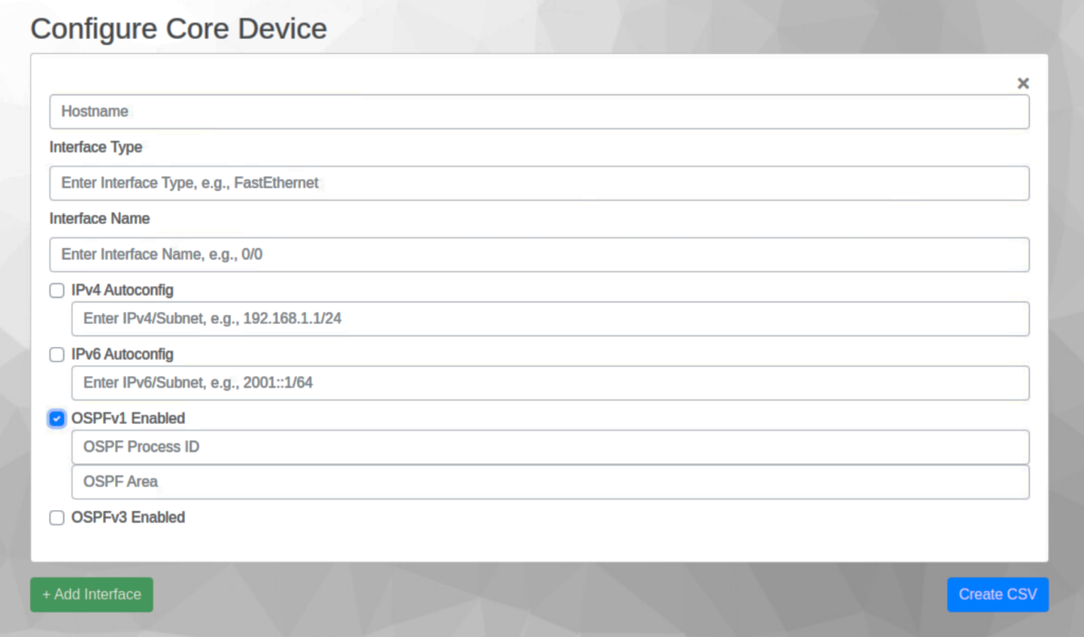
Additional Features
Main Components
Additional Features
I N P U T
Main Components
Ping Text
Server Devices
Show Commands
Difference Comparator
Core Devices
Config Download
Edge Devices
IP Validation
4

Slide 8
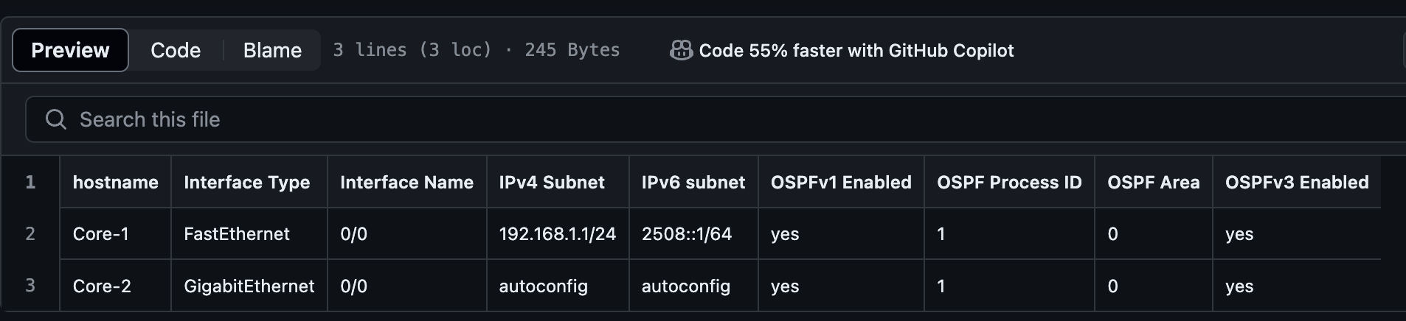

Additional Features
Main Components
Additional Features
Main Components
Ping Text
I N P U T
Show Commands
Server Devices
Difference Comparator
Core Devices
Config Download
Edge Devices
IP Validation
5

Slide 9

Additional Features
Main Components
Additional Features
Main Components
Ping Text
I N P U T
Show Commands
Server Devices
Difference Comparator
Core Devices
Config Download
Edge Devices
IP Validation
6
OUTPUT IMAGE

Slide 10





7

Slide 11
8

Slide 12
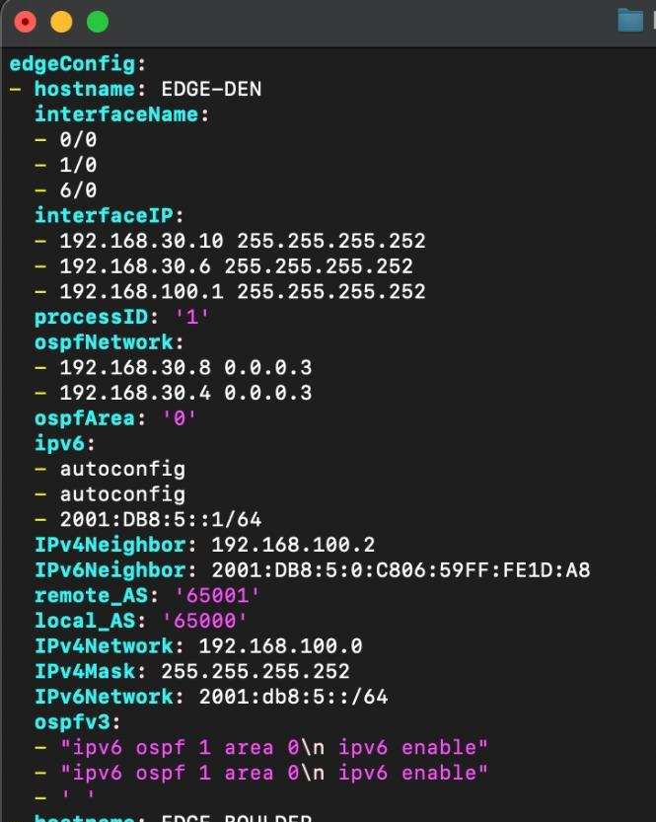
Creates Playbook
YAML format
8

Slide 13
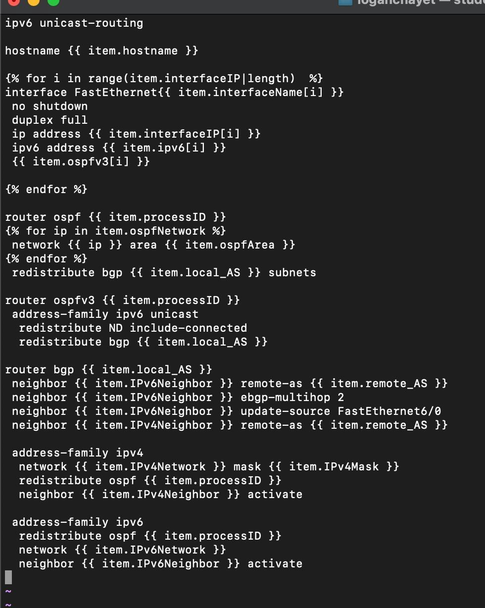
Creates Playbook
YAML format
Creates configuration
Text format
8

Slide 14
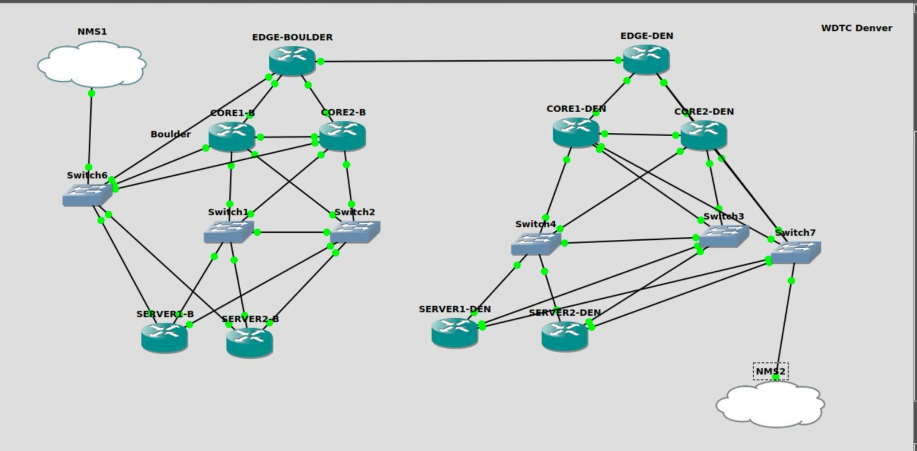
Creates Playbook
YAML format
Creates configuration
Text format
Pushes configuration
Using management IPs
8

Slide 15
Pushes configuration
Using management IPs
Creates configuration
Text format
Creates Playbook
YAML format
Ansible IMAGE
Ansible IMAGE
9

Slide 16

SNMP
Exporter
10

Slide 17
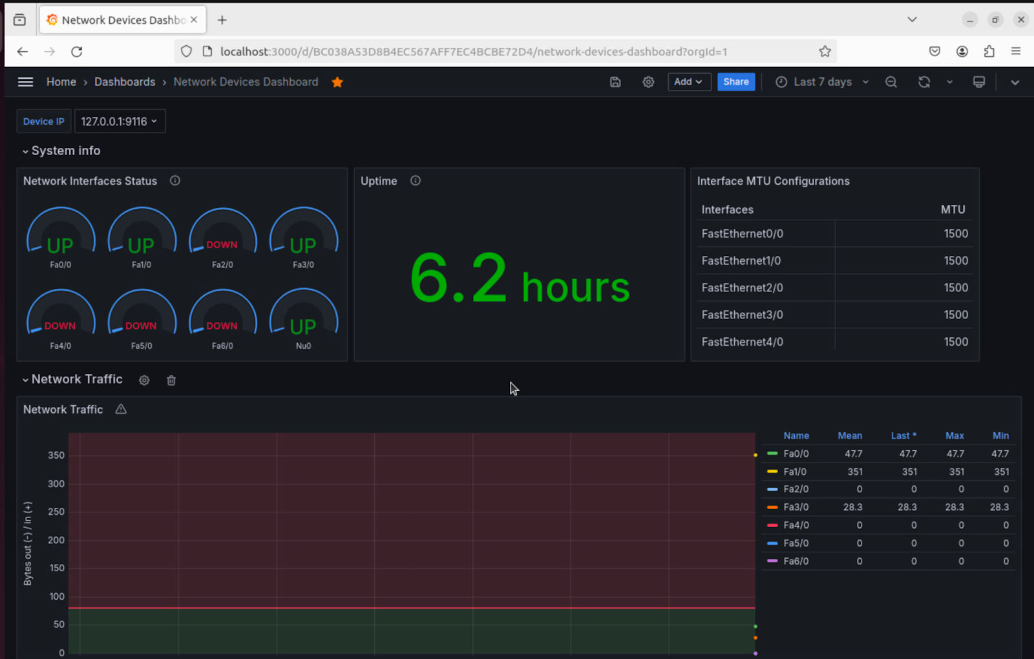
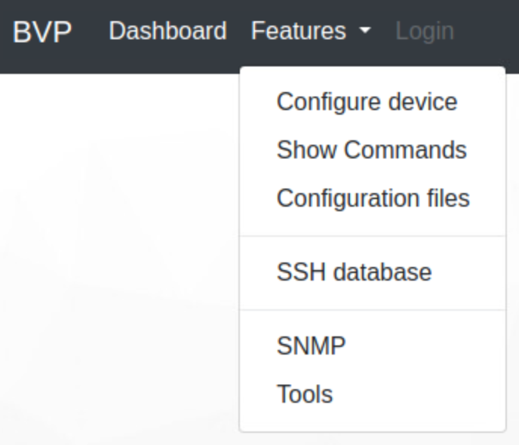

SNMP
NMAS
Makes PromQL Query
Returns data from PromQL Query
Requests metrics URL
Returns transformed data
SNMP
Exporter
SNMP Polls
SNMP Polls
SNMP Polls
11
Main Components
Edge Devices
Core Devices
Server Devices

Slide 18
SNMP
NMAS
B V P
Main Components
Edge Devices
Core Devices
Server Devices
12

